Slide 1

Developer Day 2019
Advanced Java

Slide 2





Pre-face
11

Slide 3
What to expect?
Modular with JPMS
Asynchronous programming with CompletableFuture interface
Data driven strategy with ELK
Contract driven development with GraphQL
Support multiple APIs
Reduce boilerplate code
Notes:
Future vs CompletableFuture
Assynchronous progrogramming as a way to practice the reactive manifesto

Slide 4

JAVA PLATFORM MODULE SYSTEM (JPMS)
Notes:
co-exist
Class path: where the jar files or .class files were located to be used by the runtime.
Module path: sequence of modules

Slide 5
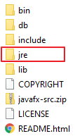
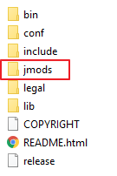
JPMS: Overview
JDK1 - JDK8
>= JDK 9
Program
packages
modules
Accessibility
4
4 + module-scope
JDK organize
a whole
modular (~100 modules)
Notes:
A module is a new way of grouping code, data and some resources, adding a higher level of aggregation above packages. Every module describes which packages are exposed and which packages of other modules your application depends on. In modules, only explicitly exported public classes can be used from other modules.

Slide 6
JPMS: Benefit
Reliable configuration
Strong Encapsulation
Maintainability & reusability
Scalability & performance
Module path vs classpath
Classpath Hell
NoClassDefFoundError
Version conflict
Shadowing
Notes:
- Reliable configuration—Modularity provides mechanisms for explicitly declaring dependencies between modules in a manner that’s recognized both at compile time and execution time. The system can walk through these dependencies to determine the subset of all modules required to support your app.
- Strong encapsulation—The packages in a module are accessible to other modules only if the module explicitly exports them. Even then, another module cannot use those packages unless it explicitly states that it requires the other module’s capabilities. This improves platform security because fewer classes are accessible to potential attackers. You may find that considering modularity helps you come up with cleaner, more logical designs.
- Scalable—Previously, the Java platform was a monolith consisting of a massive number of packages, making it challenging to develop, maintain and evolve. It couldn't be easily subsetted. The platform is now modularized into 95 modules (this number might change as Java evolves). You can create custom runtimes consisting of only modules you need for your apps or the devices you’re targeting. For example, if a device does not support GUIs, you could create a runtime that does not include the GUI modules, significantly reducing the runtime's size.
Improved performance—The JVM uses various optimization techniques to improve application performance. These techniques are more effective when it’s known in advance that required types are located only in specific modules.
- SRI: JDK is too big to scale down to small devices. JAR files, like rt.jar, are too big to be used on small devices and applications

Slide 7



JPMS: Current state
Tool support
Maven
Gradle
Eclipse
IntelliJ
Framework & library adoption
Multi Java Version
Spring, ...
Developer adoption

Slide 8
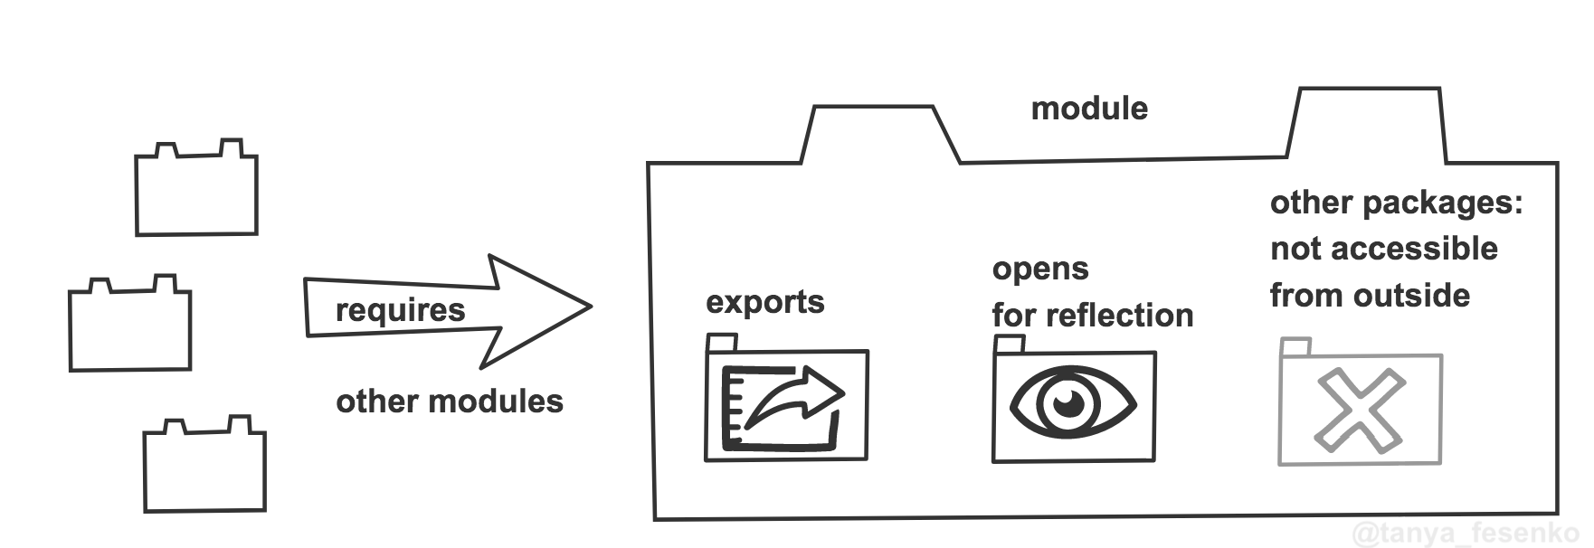
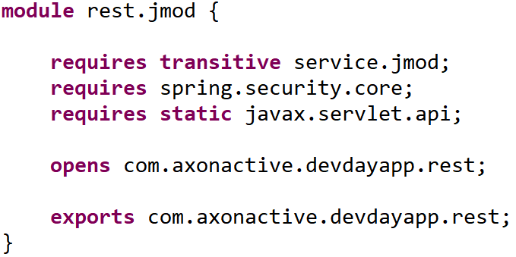
JPMS: Module overview
module-info.java

Slide 9
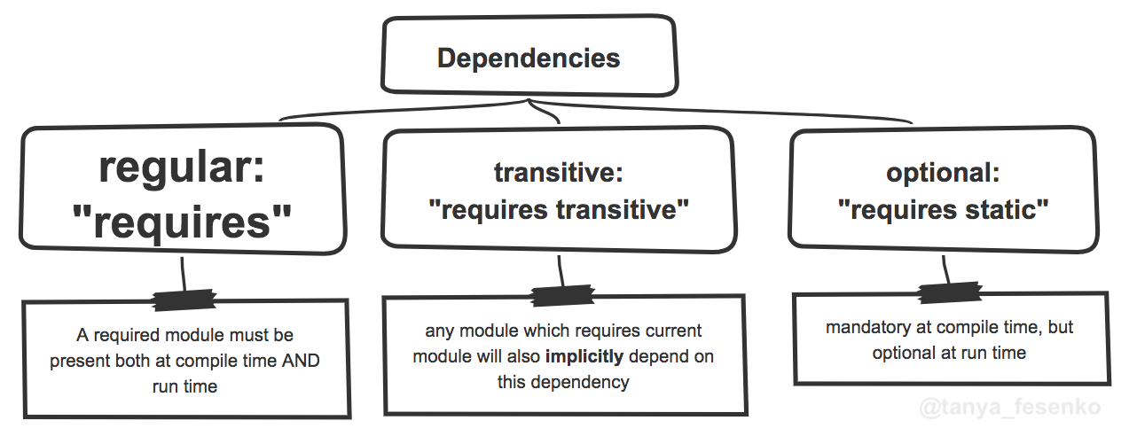
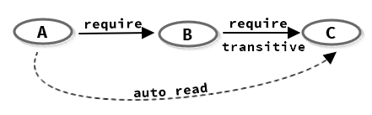
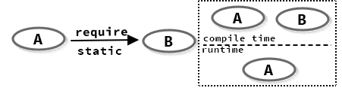
JPMS: Declaration

Slide 10
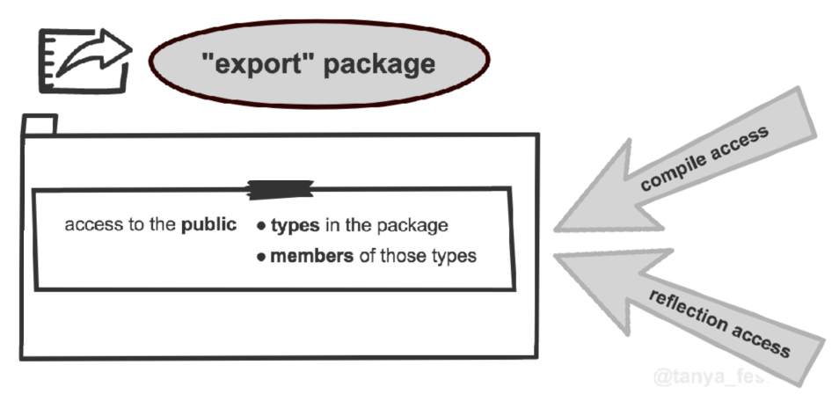
JPMS: Declaration

Slide 11
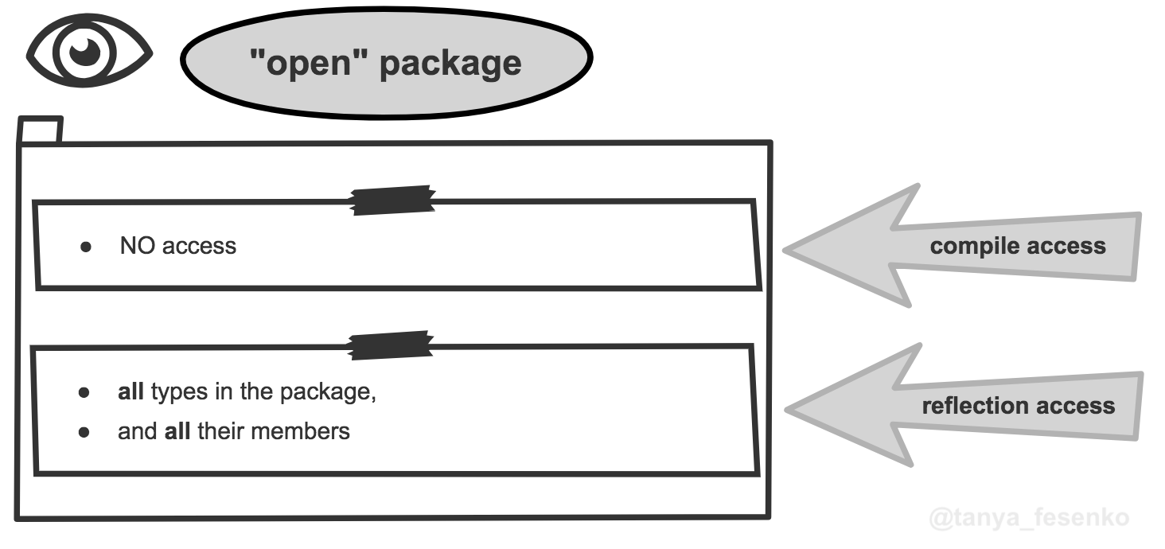
JPMS: Declaration

Slide 12
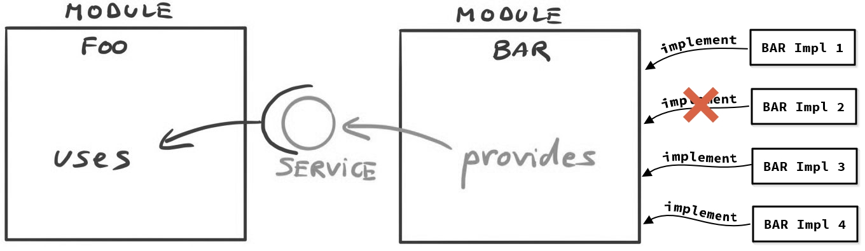
JPMS: Declaration

Slide 13
JPMS: Module Path
Notes:
- Named module: a module created with a module declaration file module-info.java in its folder.
- Unnamed module: a jar built without module-info.java declaration
Named modules does not allowed to read unnamed modules
- Automated modules: Module name derived from its jar name, or if it has a Manifest entry Automatic-Module-Name, the module name will be its value.
You are working on a Java module application, but one of your dependencies is not a module, and you don't have access to that code to convert it into an application module. A normal jar can be converted into a module by putting this library in the module-path instead of the classpath -> it immediately becomes an “automatic module.

Slide 14
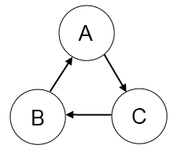
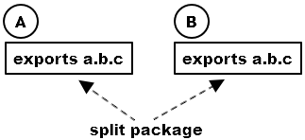
JPMS: Migration challenges
Encapsulated JDK internal APIs
Cyclic dependencies
Split package
Limited support of jlink^{(*)} & build plugin to build runtime image
(*) jlink: jdk tool to generate runtime image

Slide 15
JPMS: Get started
Step 1: Determine module's boundary
Step 2: Prepare module structure & refactor code
Step 3: Add module descriptors bottom-up
Step 4: Resolve issues & make the aplication work

Slide 16










Thread1
Thread2
Thread3
COMPLETABLE FUTURE
JAVA8

Slide 17
COVER
1. FUTURE INTERFACE, CALLABLE OBJECT, EXECUTOR SERVICE
2. COMPLETABLE FUTURE
3. THINGS TO DO

Slide 18
FUTURE INTERFACE
Since JAVA5

Slide 19
TRADITIONAL VS MODERN ASYNCHRONOUS
TRADITIONAL
JAVA FUTRURE
Runnable
Callable
MainThread
MainThread
Separate Thread
Separate Thread
Task
Task
doSomething
doSomething
Runnable
Callable
Return Value with get()
Thread thread2 = new Thread(new Runnable() {
@Override
public void run() {
System.out.println(2 * 3);
}
});
//do something else
thread2.start();
thread2.join();
Future<Integer> future = executor.submit(
new Callable<Integer>() {
public Integer call() throws Exception {
return 2 * 3;
}
});
//do something else
System.out.println(future.get());

Slide 20

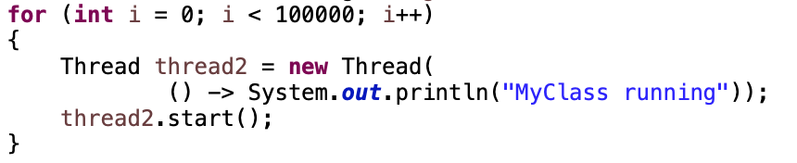
EXECUTOR SERVICE FOR BETTER PERFORMANCE
EXECUTOR SERVICE
Thread Pool
Submit Tasks
Thread1
Task
1
Task
2
Task
3
…
Task 100000
Thread2
Java Executor Service
…
Thread10
ExecutorService executor = Executors.newFixedThreadPool(10);
for (int i= 0; i < 100000; i++) {
executor.submit(() -> System.out.println("My Class is running"));
}
Notes:
Advantage;
Thread Creation, Thread Management, Task submission and execution
shutdown()
shutdownNow()

Slide 21
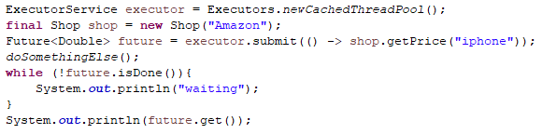
FEATURES OF FUTURE
isDone()
isTerminal
cancel()
isCancel()

Slide 22
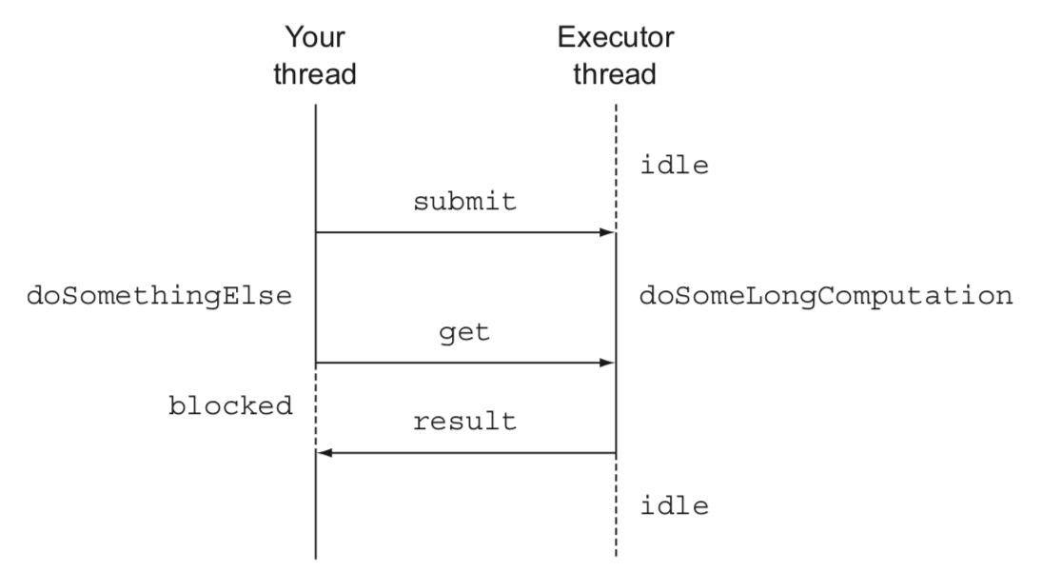
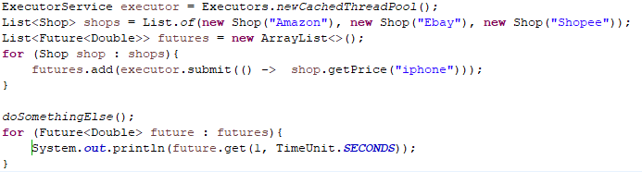
FEATURES OF FUTURE
List of Futures
isDone()
isTerminal
cancel()
isCancel()
get(timeout, unit )

Slide 23

COMPLEX BUSINESS
Thread1
Thread2
Thread3
Asynchronous
Synchronous
Manually Completed
HandleException
Non-blocking

Slide 24
DISADVANTAGE OF FUTURE
Thread1
Thread2
1. Non-blocking
2. Manually Completed
3. Multiple Futures chain(Synchronous)
4. Multiple Futures combine (Asynchronous)
5. Exception Handling

Slide 25
findPrice()
getNonDiscountPrice()
COMPLETABLE FUTURE
Since JAVA8
extractData()
getDiscountPercent()
calculate()

Slide 26
Executor Thread
SUPPLYASYNC
findPrice()
getNonDiscountPrice()
Amazon|20$|Gold
private final static Executor executor = Executors.newFixedThreadPool(100);
public static CompletableFuture<String> findPrice(String product) {
Shop amazon = new Shop(”Amazon");
return CompletableFuture.supplyAsync(() -> amazon.getNonDiscountPrice("iphone11”), executor);
}
<U> CompletableFuture<U> supplyAsync(Supplier<U> supplier)
<U> CompletableFuture<U> supplyAsync(Supplier<U> supplier, Executor executor)

Slide 27

Executor Thread
Executor Thread
SUPPLYASYNC
findPrice()
getNonDiscountPrice()
getNonDiscountPrice()
Amazon|20$|Gold
Ebay|22$|Silver
private final static Executor executor = Executors.newFixedThreadPool(100);
static List<Shop> shops = List.of(new Shop("Amazon"), new Shop("Ebay"), new Shop("Shopee"));
public static Stream<CompletableFuture<String>> findPrice(String product) {
return shops.stream().map(
shop -> CompletableFuture.supplyAsync(() -> shop.getNonDiscountPrice("iphone11"), executor));
}
<U> CompletableFuture<U> supplyAsync(Supplier<U> supplier)
<U> CompletableFuture<U> supplyAsync(Supplier<U> supplier, Executor executor)

Slide 28

Executor Thread
findPrice()
THENAPPLY
getNonDiscountPrice()
Amazon|20$|Gold
public static Stream<CompletableFuture<Quote>> findPrice(String product) {
return shops.stream()
.map(shop -> CompletableFuture.supplyAsync(() -> shop.getNonDiscountPrice("iphone11")))
.map(future -> future.thenApply(Quote::parse));
}
parse()
Price: 20|Discount: Gold
<U> CompletableFuture<U> thenApply (Function<? super T,? extends U> fn)
<U> CompletableFuture<U> thenApplyAsync(Function<? super T,? extends U> fn)
<U> CompletableFuture<U> thenApplyAsync(Function<? super T,? extends U> fn, Executor executor)

Slide 29


Executor Thread
findPrice()
THENCOMPOSE
getNonDiscountPrice()
parse()
Gold
getDiscountPercent()
public static Stream<Object> findPrice(String product) {
return shops.stream()
.map(shop -> CompletableFuture.supplyAsync(
() -> shop.getNonDiscountPrice ("iphone11"), executor))
.map(future -> future.thenApply(Quote::parse))
.map(future -> future.thenCompose(
quote -> CompletableFuture.supplyAsync(
() -> Discount.getDiscountPrecent(quote), executor)));
}
20%

Slide 30



Executor Thread
Executor Thread
findPrice()
THENCOMBINE
From:$ To:VND
getNonDiscountPrice()
getExchangeCurrency()
22500
parse()
getDiscountPercent()
public static Stream<Object> findPrice(String product) {
return shops.stream()
.map(shop -> CompletableFuture.supplyAsync(
() -> shop. getNonDiscountPrice("iphone11"), executor))
.map(future -> future.thenApply(Quote::parse))
.map(future -> future.thenCompose(
quote -> CompletableFuture.supplyAsync(
() -> Discount.getDiscountPercent(quote), executor)))
.map(future -> future.thenCombine(
CompletableFuture.supplyAsync(() -> ExchangeService.getRate("USD", "VND")),
(quote, rate) -> quote.getShopName() + " " + quote.getDiscount() * rate));
}
Quote
calculate()

Slide 31
public static Stream<Object> findPrice(String product) {
return shops.stream()
.map(shop -> CompletableFuture.supplyAsync(
() -> shop. getNonDiscountPrice("iphone11"), executor))
THENACCEPT
CompletableFuture[] futures = findPrice(”iphone11")
.map(f -> f.thenAccept(
s -> System.out.println(s)))
.toArray(size -> new CompletableFuture[size]);
thenAccept()
Executor Thread
findPrice()
thenAccept()
Executor Thread
findPrice()
ALLOF/ANYOF
CompletableFuture.allOf(futures).join();
join()

Slide 32
HANDLE EXCEPTION
public static Stream<CompletableFuture<String>> findPrice(String product) {
return shops.stream()
.map(shop -> CompletableFuture.supplyAsync(() -> shop.getPrice("iphone11"), executor))
.map(future -> future.exceptionally(ex -> {return ”Unknow";}
));
}

Slide 33
THINGS TO DO
supplyAsync
supplyAsync
SIMPLE!!!
Apply Completable Future in
DefaultSearchingService.java
thenApply
thenCombine
thenCompose
thenCombine
thenAccept

Slide 34

Data driven strategy with ELK
Notes:
-Have you ever been tired of:
doing a lot of steps to read logs?
open lots of log files and sometimes you cannot remember where are they?
-You are not developer and found the logs are hard to understand?
-You want to make a big change in your company system and your boss need to know the current situation of system. They are in system logs but how to present it in a straightforward and more impressive way to you boss?
-All of them will be resolve with our topic today.. How about if we have one place to read all of your logs and moreover, you can find an event in your all logs in nearly a seconds?
-Let come to ELK stack, one solution can resolve all of your log problem
-What ELK stack could bring to us?
We can monitor production, resource usage
Performance analyze
Tracking client request, keytrend
We can see log immediately, reduce the risk of lost log files
Non-developer could understand situation of sytem
Find event faster, easier.
-So, what is ELK, how to make it work?
ELK is short of Elasticsearch - logstash - kibana.
Logstash..
Elasticsearch..
Kibana…
And last but not least, how to apply for it?
- Know your log structure
- Parse log
- Visualize

Slide 35

server response time?
product's customer usage?
most called service?
resource usage?

Slide 36
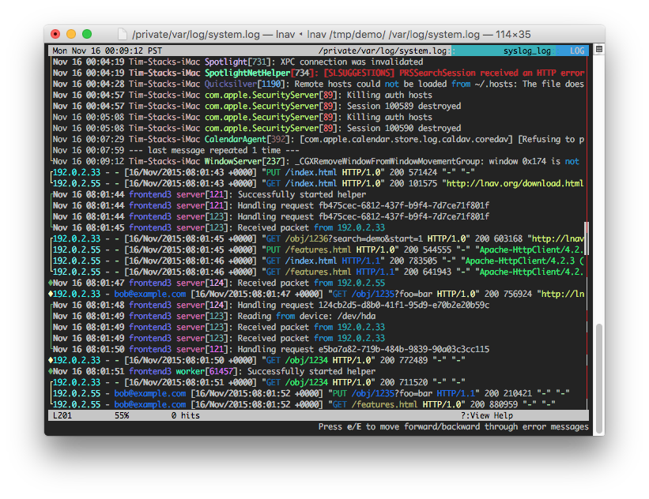
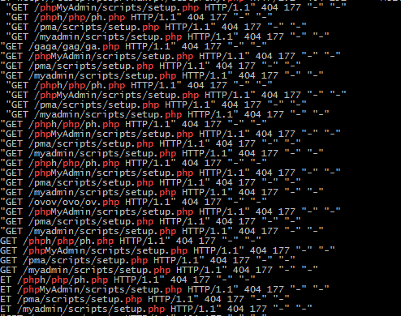

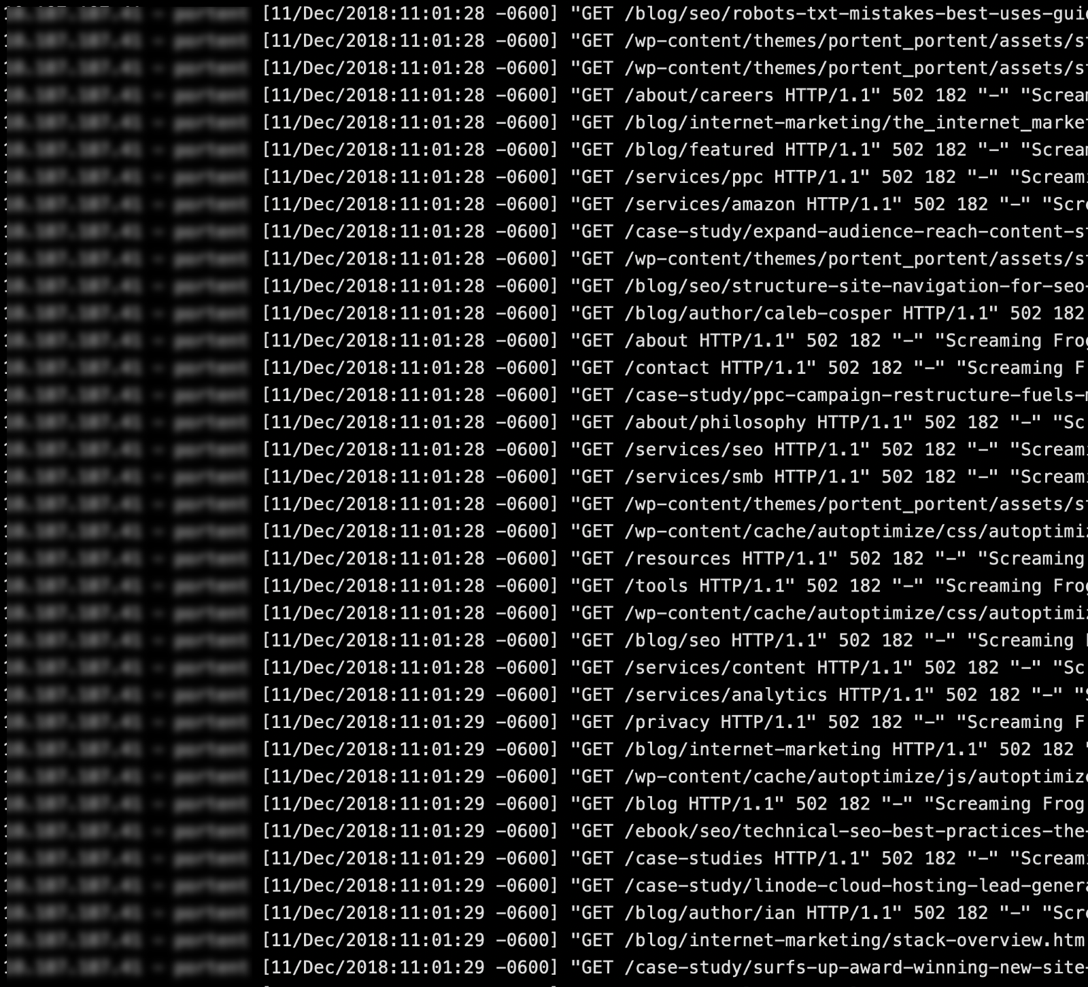

Slide 37
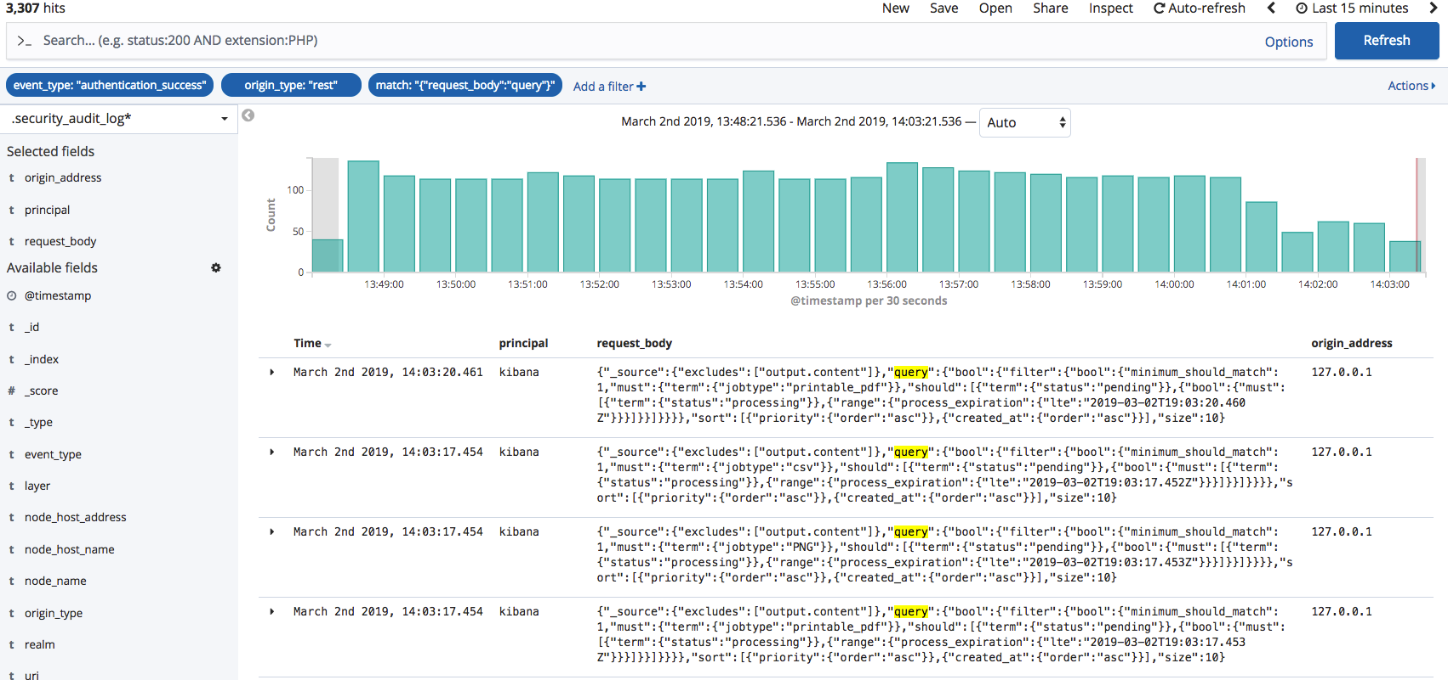

How about?

Slide 38
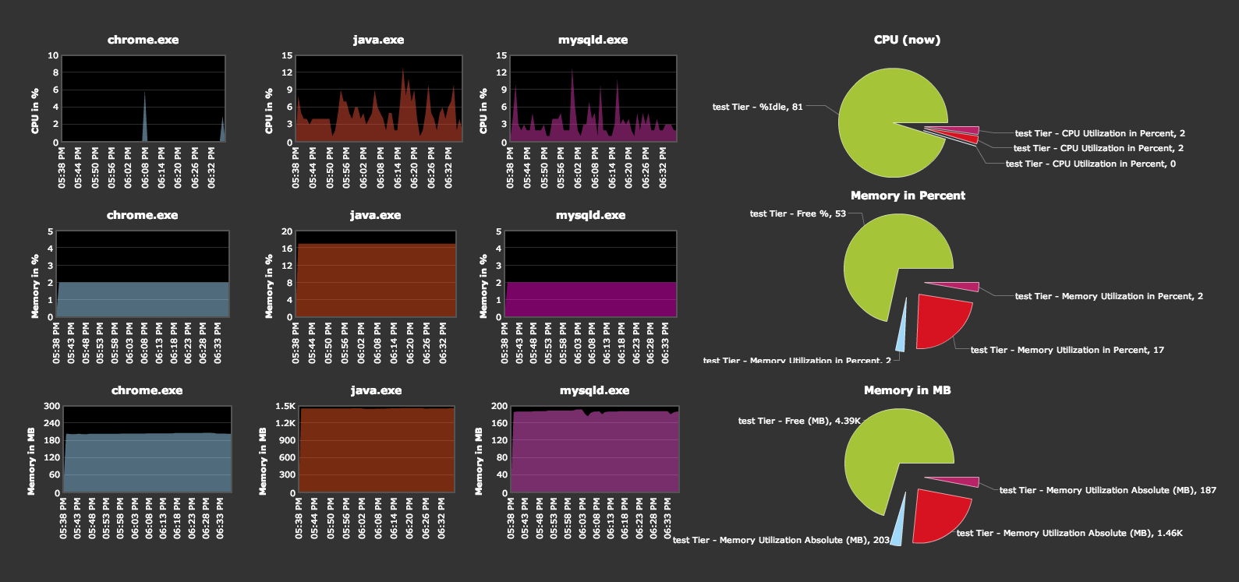
Benefits
Production monitoring and debugging
Resource usage

Slide 39
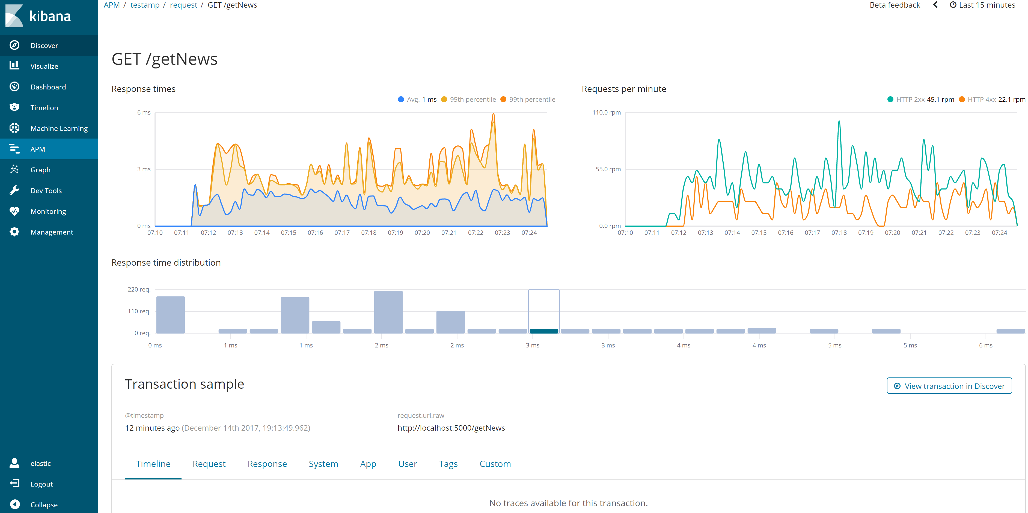
Benefits
Performance analysis

Slide 40
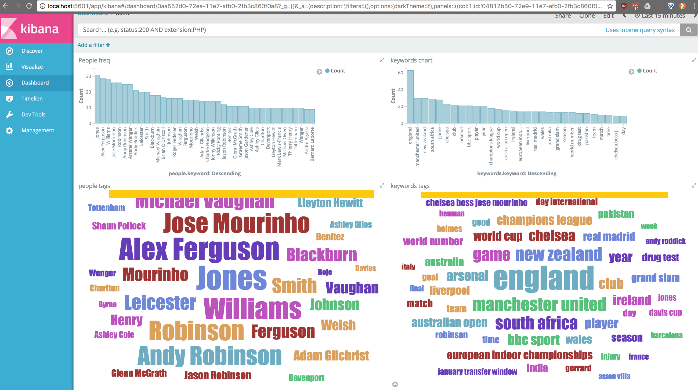
Benefits
Tracking client requests
Identifying key trends

Slide 41

Benefits
Live logging
Understand more about system

Slide 42
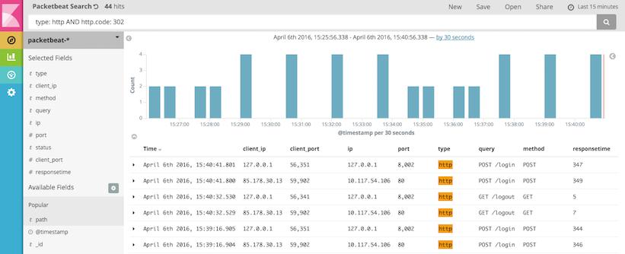
Benefits
Easy to read
Easily and quickly to find information

Slide 43
What is ELK?

Slide 44

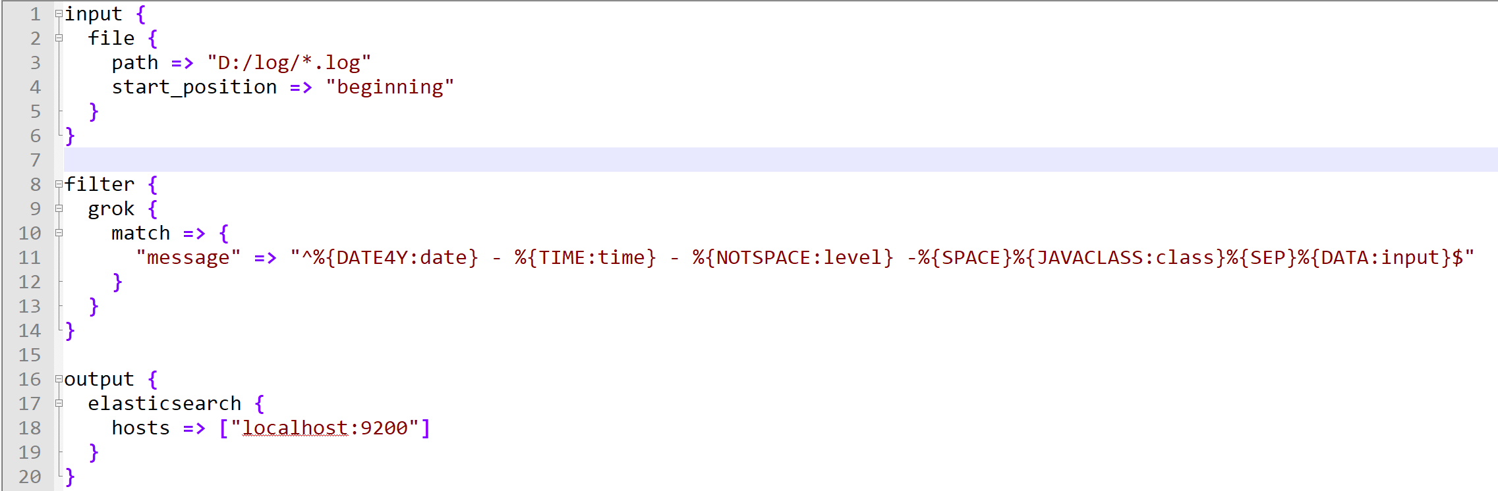
Logstash
Parse log line into the readable format

Slide 45

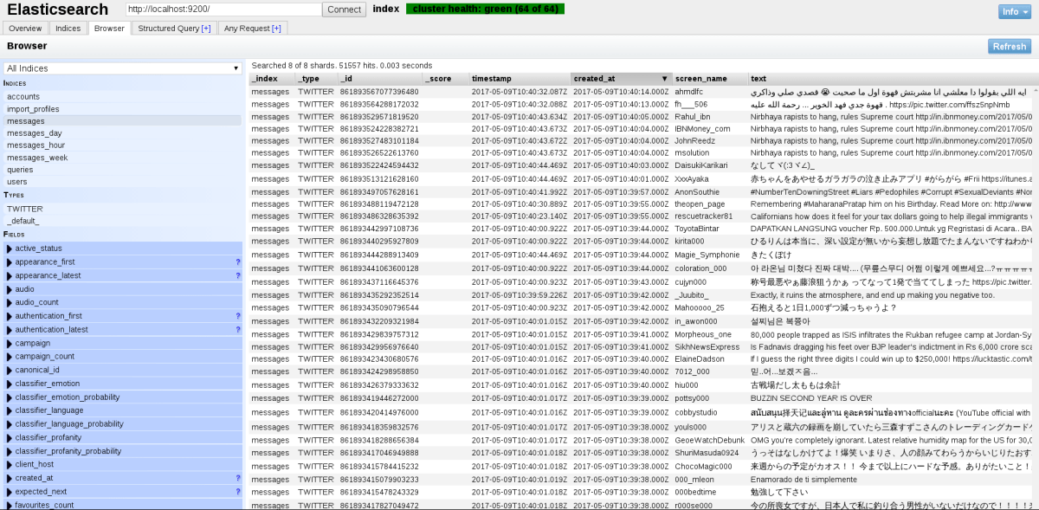
Elasticsearch
Act as a data source for Kibana

Slide 46

Kibana
Visualize information using charts, table, ...

Slide 47
Do more with our application
1. Know your log structure
2. Parse log by Logstash
3. Visualize by Kibana (at least 1 chart)

Slide 48

How to write clean code?
Devday 2014
Notes:
In computer programming, boilerplate code or boilerplate refers to sections of code that have to be included in many places with little or no alteration. It is often used when referring to languages that are considered verbose, i.e. the programmer must write a lot of code to do minimal jobs.

Slide 49
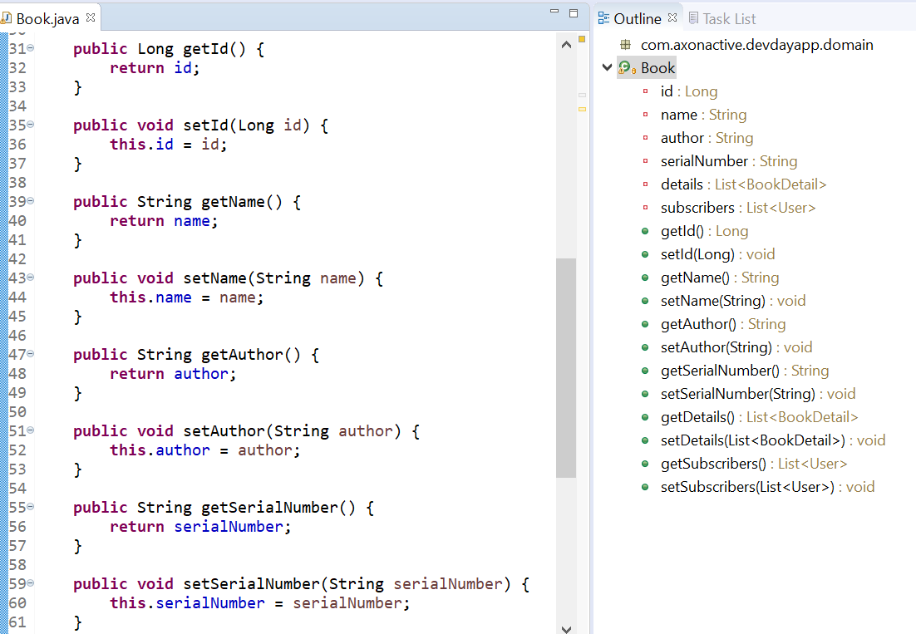

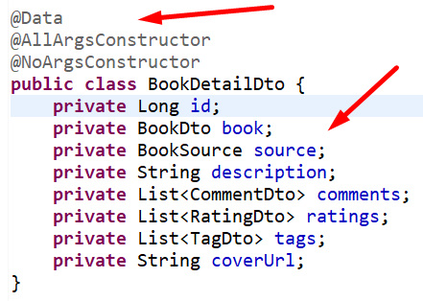
Clean Code
Clean code is a continuous process.
Don’t live with broken windows
Naming thoughtfully
Function should be small and smaller.
Do One Thing
Extract Till You Drop

Slide 50
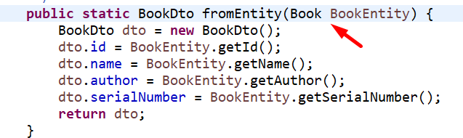
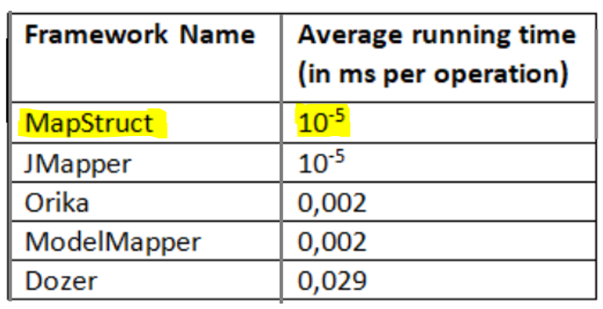
Another example
BookDetail → BookDetailDto
Commnent → CommentDto
Tag → TagDto
User → UserDto
…..
https://www.baeldung.com/java-performance-mapping-frameworks

Slide 51
Do more with our application
1. Reduce getters/setters/constructors
2. Reduce manual converters

Slide 52
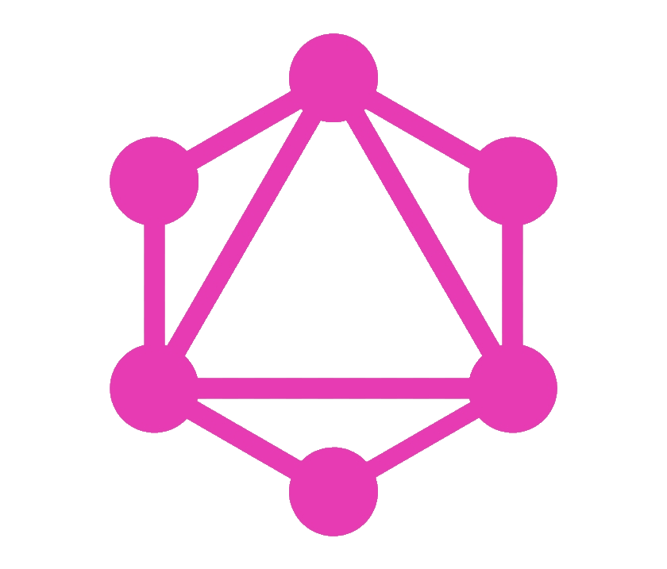
Contract driven development with GraphQL

Slide 53

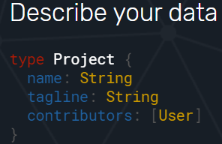
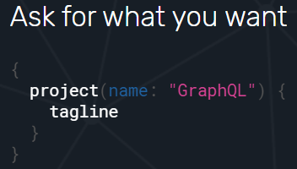
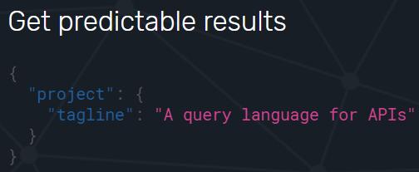







GraphQL
Describe your data
Ask for what you want
Get predictable results
Enable Contract Driven Development
Notes:
GraphQL is a very exciting new technology that can potentially revolutionize the way that Web APIs are developed.
1. Describe what’s possible with a type system
2. Ask for what you need, get exactly that (REST API can’t not)
3. Get many resources in a single request - 5. Bring your own data and code
4. Evolve your API without versions
https://graphql.org/
https://topdev.vn/blog/graphql/
https://www.graphql-java.com/tutorials/getting-started-with-spring-boot/

Slide 54
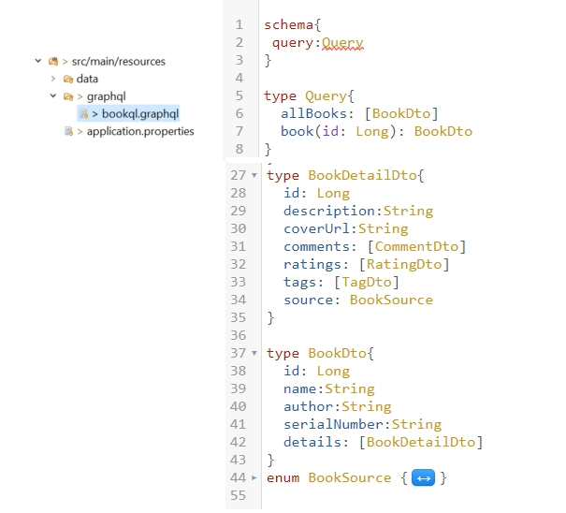
Describe your Data
Notes:
schema, queries, và resolvers
The schema describes what queries are possible and what fields you can get back.
Resolver nói cho GraphQL biết nơi và cách thức để lấy data cần thiết cho field của query mà bạn yêu cầu

Slide 55
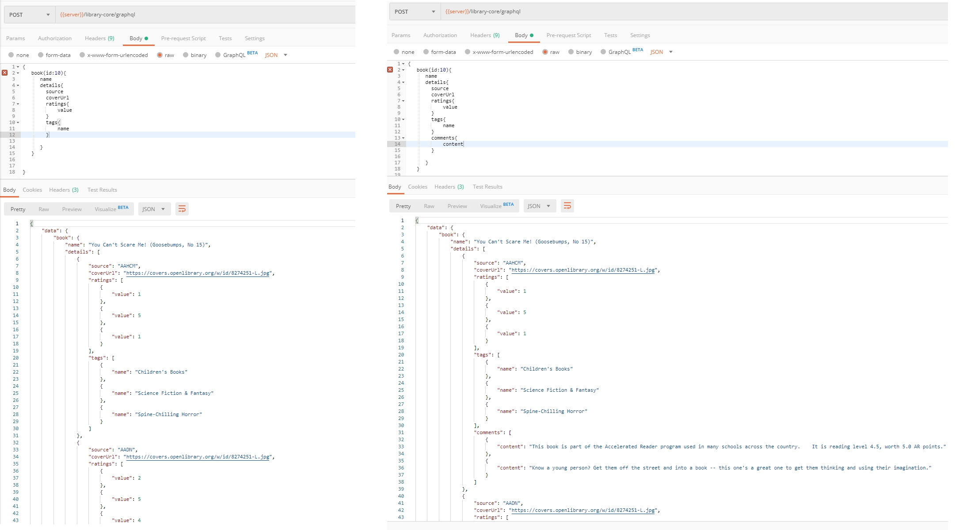
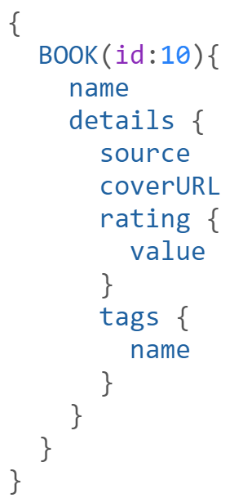
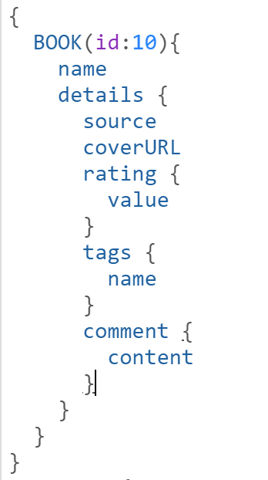
Ask for what you want (based on the schema, of course)

Slide 56
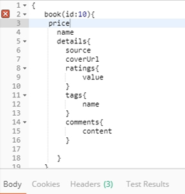
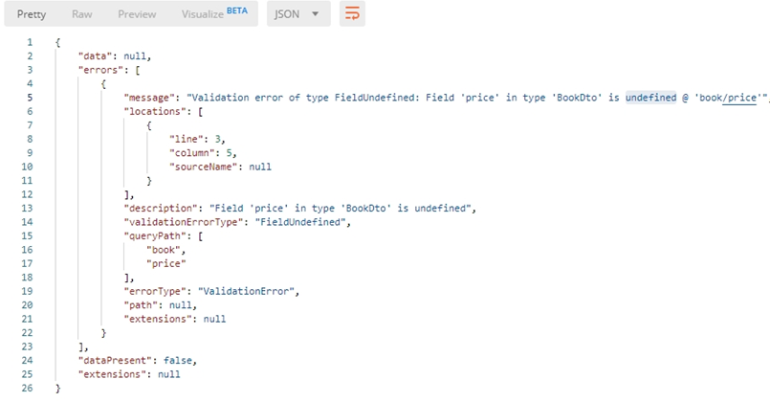
When I try to be naughty and ask for something not on the schema

Slide 57
Do more with our application
Apply GraphQL on existing endpoints
Demonstrate how it work

Slide 58
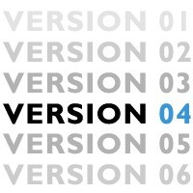
API versioning

Slide 59
Support Multiple API version
Everything will change and grow
Backward compatible (aka: not breaking existing clients)
How?
Point to point: URL
/library-core/api/v1
/library-core/api/v2
Compatible:
1. Query parameter /api/People?api-version=1.0
2. Custom request header:
api-version: 2
3. Accepted header: (Content negotiation)
Accept: application/vnd.haveibeenpwned.v2+json
4. Continuous versioning
Notes:
“The correct handling of API versioning has been one of the most difficult issues faced by developers of distributed systems. Various schemes have been proposed, ranging from the laissez faire approach taken by CORBA (Common Object Request Broker Architecture) to the stricter schemes used in DCOM (Distributed Component Object Model). With the advent of Web services, there are some new features that you can take advantage of that can help alleviate the problem, but the brutal fact of the matter is that versioning has not been built into the Web services architecture.”

Slide 60
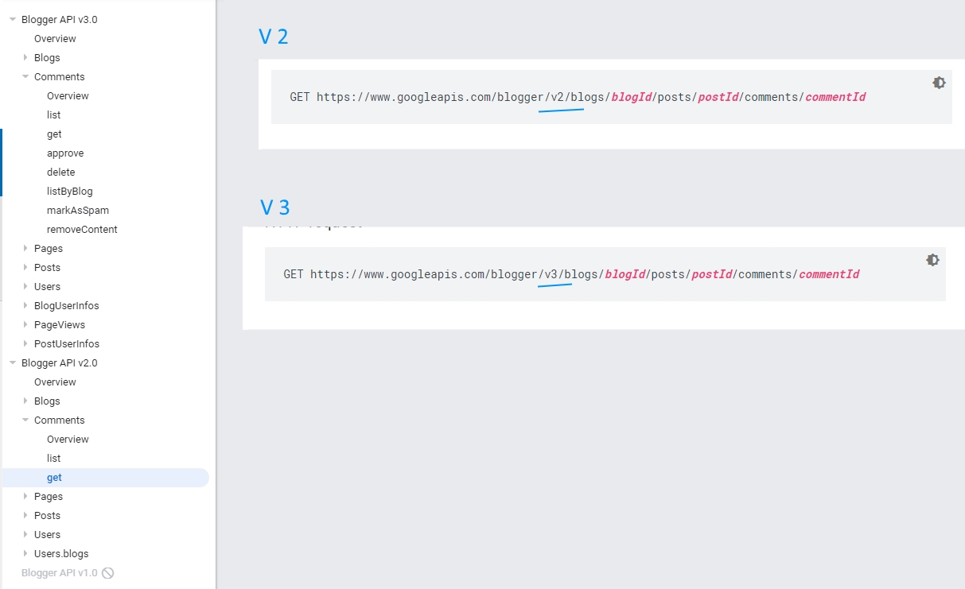
Point to point
URLs:
https://www.googleapis.com/blogger/v2/blogs/...
https://www.googleapis.com/blogger/v3/blogs/...
DevOps
Footprints
Maintenance
Notes:
Same approach: Twitter
Trace off:
need strong devops
Leave big footprint

Slide 61
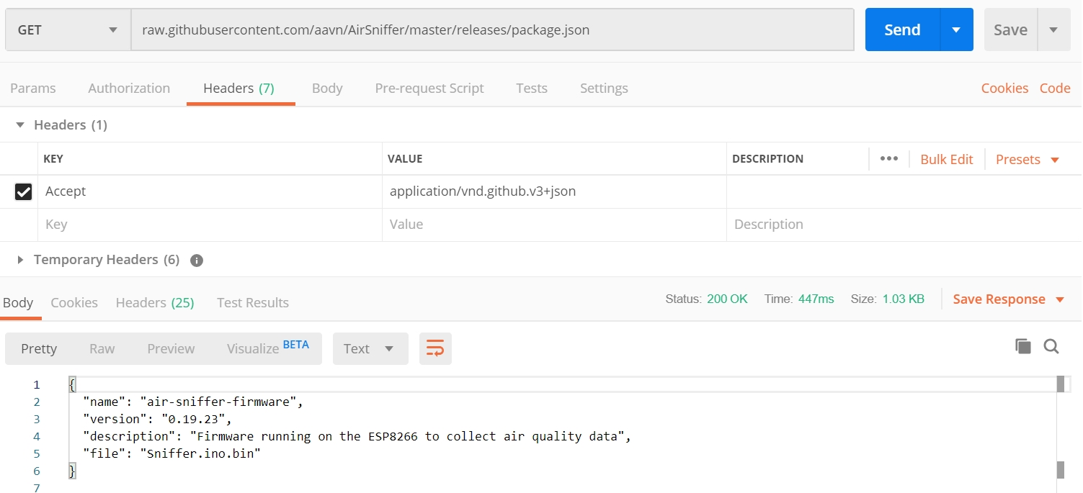
Compatible
Accepted header: Accept: application/vnd.github.v3+json
Consumer’s effort Not calling directly from browser
Not easy to test
Notes:
Control more
Not Expose version on url
Trace off:
Be ware off firewall
Convention/Standardise?
HTML form
Difficult to test
Cannot call directly from browser

Slide 62
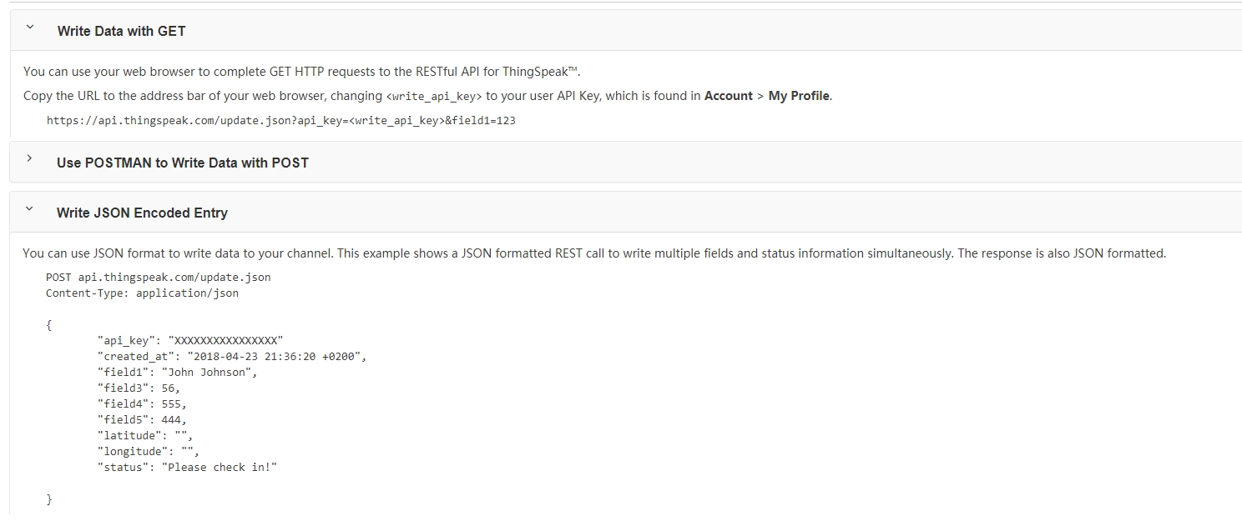
Compatible
Continuous versioning
Engineering awareness
Notes:
Trace off:

Slide 63
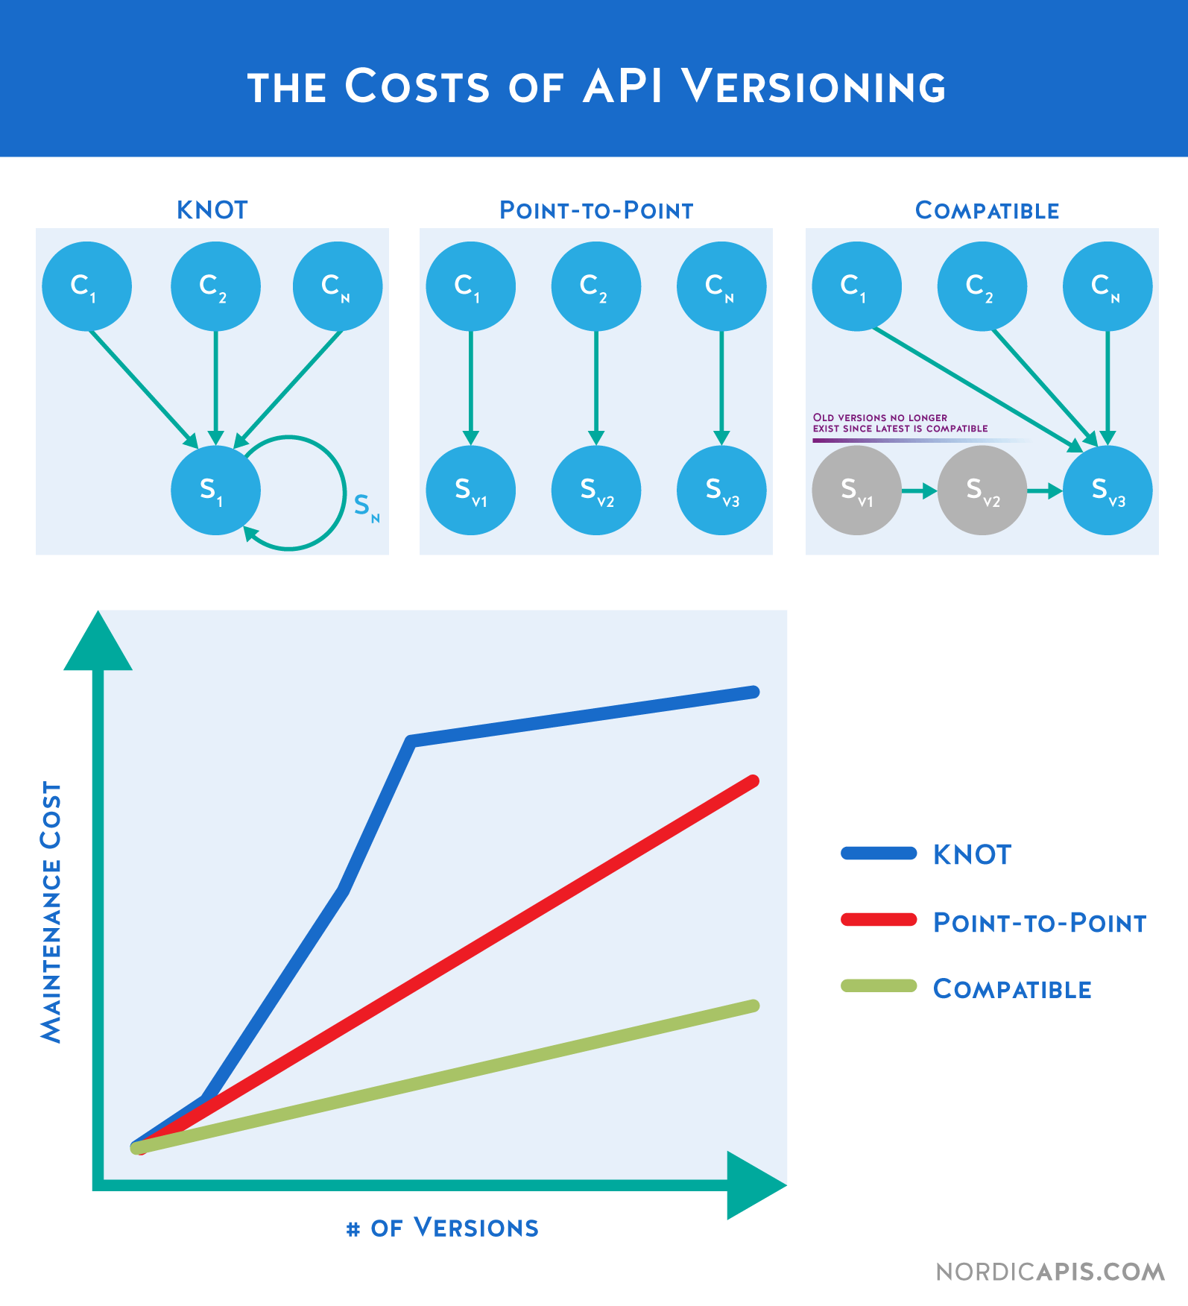
Which way is better?
Product need
Business motives
Vision
Notes:
The Knot. "All API consumers are tied to a single version of the API, when that API changes, all consumers have to change, in essence creating a massive ripple effect across the entire set of consumers / ecosystem.“
APIs can be among your greatest assets or liabilities. Good APIs create long-term customers; bad ones create long-term support nightmares.
Public APIs, like diamonds, are forever. You have one chance to get it right so give it your best.

Slide 64
Do more with our application
Apply Compatible approach
Develop V2 of the search API
Demonstrate that you can support both V1 & V2

Slide 65

Back-end business domain: library
swagger-ui link
Notes:
Add link to swagger

Slide 66
How to make V2?
Do not modify /master branch
Make a new branch(es) for your chosen exercise
How many exercises?
Apply JPMS
Analyze application behavior using ELK
Apply Future interface for calling external resources
Apply GraphQL
Support multiple API versions
Reducing boilerplate code
…
How many exercises have to be finished?
Your team decision
Notes:
How & who will check your exercise: your supporters

Slide 67
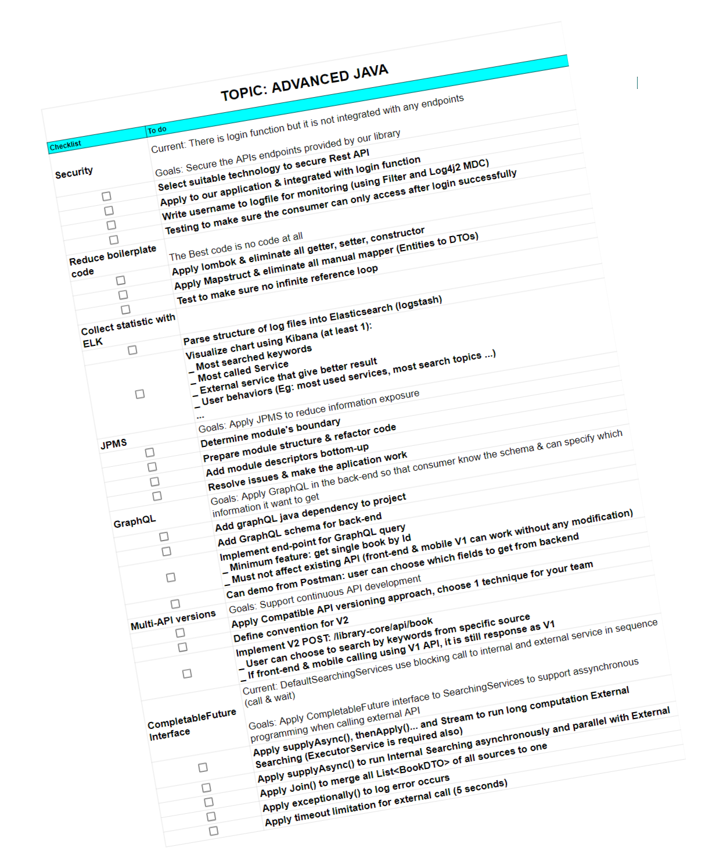
Checklist for V2(s)
Please stay in touch with your supporters

Slide 68
Some other Hypes
Open JDK
Jakarta EE
Microprofile
Notes:
Just for back-up for audience satisfaction
JPMS & microprofile

Slide 69

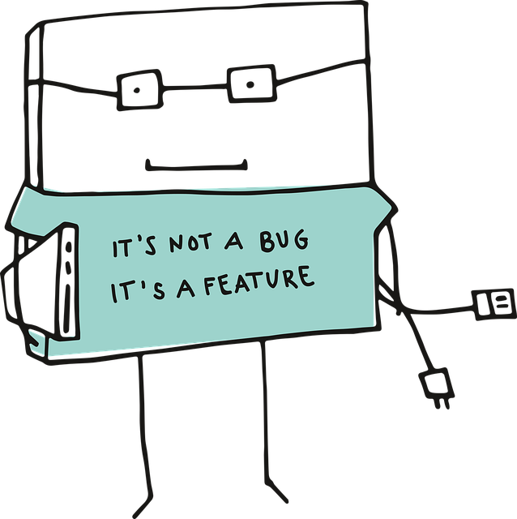
THANK YOU!

